Slide 1
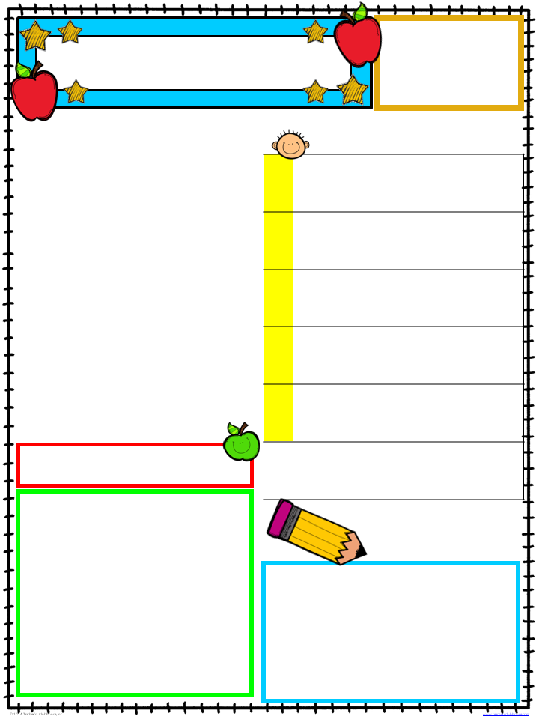
Michelle Lewis
1st Grade
985-688-5955
mlirette@assumptionschools.com
Peek At Our Week
September 24-28, 2018
A Peek at Our Week
Writing:: Opinion Paragraph
This week students will write and revise opinion paragraphs using the parts of a stoplight paragraph.
MON
TUE
Social Living: Community
Students will discuss in detail the roles, responsibilities and services that community helpers provide to make our town a productive and orderly community.
WEEKLY HOMEWORK
MON-THU
Community Helper Interview
Friday
Homework Due
From
Teacher’s Desk
the
Last week first grade went on a field trip to the Sheriff’s office, Capitol One Bank, Courthouse, Fire Department,
Library, and Assumption Hospital. We had a blast! I was so proud of the questions and comments that our young children had. I would like to give a special shout out to the organizations and businesses that hosted us for being so generous in their time, support, patience and even their heart-felt presents for each child. Napoleonville is a beautiful community that is maintained by the honorable efforts of the many individuals that we met last Thursday. While we did not have time to visit the post office, children who returned their envelopes last Wednesday should receive their letter in the mail this week. To further extend students understanding of community helpers, their homework this week is to interview one.
Mark Your
Calendar
Thursday, Sept. 28
in class
opinion writing (graded)
Friday, Sept. 29
Community Helpers test

