Slide 1
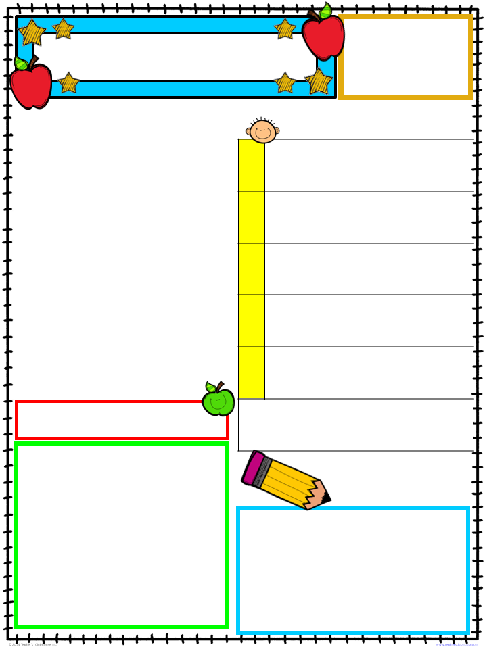
Michelle Lewis
1st Grade
www.mrslewisclass.com
Peek At Our Week
January 14-18, 2019
A Peek at Our Week
Writing:: Opinion Paragraph
This week students will write and revise an opinion paragraph on which event from the past, present or future is the best. They will implement the parts of a stoplight paragraph.
MON
TUE
Social Living:
Past, Present, Future
Students will discuss in detail how time changes and history is made.
WEEKLY HOMEWORK
MON-THU
Past, Present, Future
Friday
Homework Due
From
www.mrslewisclass.com
Teacher’s Desk
the
Welcome back, I hope that you and your family had a restful and invigorating holiday break. As the second half of the year begins, I would like to thank you for your continued support. We are a team and stronger together. I wholeheartedly appreciate your donations to our class maker station (toilet paper rolls, Kleenex boxes, etc.), your assistance with homework, and your overall positive attitude and willingness to help. It is a blessing and deeply appreciated.
Please remember to visit
www.mrslewisclass.com for weekly updates, additional resources, and a look at fun in class projects.
Mark Your
Calendar
Friday, Jan. 18
Opinion Writing

