Slide 1
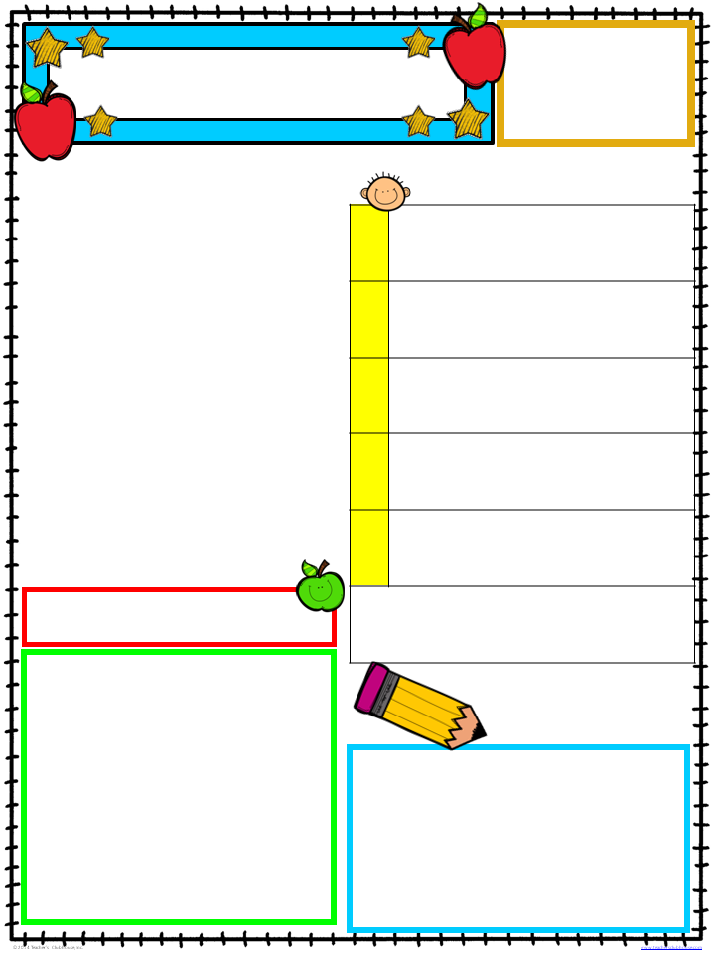
Michelle Lewis
1st Grade
985-688-5955
www.mrslewisclass.com
Peek At Our Week
October 1-5, 2018
WEEKLY HOMEWORK
A Peek at Our Week
Social Living:: Making Observations
This week students will learn that scientists use their five senses to observe and evaluate our world.
Mon. –Thurs.
5 senses Fall observations
Friday
Homework Due
Writing: Opinion Paragraph
We will finish working on our opinion paragraphs. Students have worked very diligently and are making strong progress in their writing.
From
www.mrslewisclass.com
Visit for pictures, class information
and more.
Teacher’s Desk
the
Students have been working extremely hard on stepping into first grade standards and expectations. I appreciate your support in helping with homework and texting, calling, or emailing me with your questions and concerns. I greatly value your feedback and know that it is our shared effort that is making your child successful. Thank you.
Mark Your
Calendar
Looking Ahead:
Science test: October 5, 2018

